Slide 1

The importance of the Magna Carta and the Westminster system 1215–present

Slide 2
1167–1216 King John I — start of a shift in the power of the monarch
Issue
King John I, ruler of England, increased the taxes paid by wealthy noblemen (barons and bishops) to pay for his wars with France and the governance of England. He also handed out harsh penalties to anyone who opposed his orders.
Points of view on the issue
King John believed that he alone had the absolute power or divine right* to make decisions about running the country.
The barons and the bishops objected to increased taxes and wanted more say in how the money raised in taxes was spent. They also wanted a say in how England was governed and how laws were applied.
* Divine right to rule came from God and the king was not subject to any earthly authority.

Slide 3
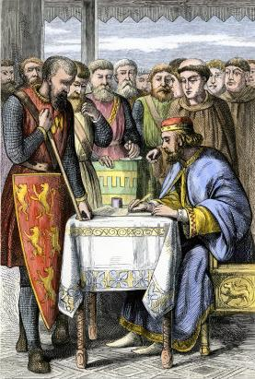
1215 King John signs the Magna Carta — start of a shift in the power of the monarch
Resolution of the dispute
Rebel barons and bishops seized London and the king was forced to negotiate terms.
King John I of England signed the Magna Carta or the ‘Great Charter’.
The importance of the solution
The Magna Carta limited royal power, outlined the rights and freedoms of English people, including habeas corpus (that is, the right to the presumption of innocence until proven guilty in a court of law), and signalled the beginning of democracy*.
Political and legal processes in former British colonies, such as Australia, have been influenced by the Magna Carta.
* government by the people

Slide 4
1215–58
Emergence of the Great Council
— bringing together groups with different points of view
Between 1215 and 1258, whenever the monarch and the barons met, such meetings were called the Great Council.
Around 1258 these Great Councils started to be called a parliament*.
* parliament comes from the French word, ‘parle’, which means to speak

Slide 5
1215–58
Representation for taxation
— bringing together groups with different points of view
Issue
During the second half of the 13th century, King Henry III, son of King John, began to tax knights and wealthy townspeople.
Points of view on the issue
The king needed more money to fights his wars, run the country and pay for his servants.
The knights and wealthy townspeople wanted to have a say in the running of the country, if they were to be taxed.

Slide 6
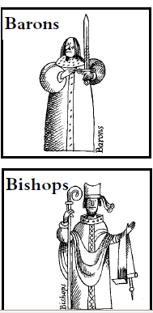
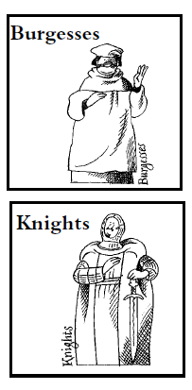
1215–58
Representation of different groups in parliament
— bringing together groups with different points of view
Resolution of the dispute
The knights and wealthy townspeople were invited to parliament.
The importance of the solution:
Two houses of parliament were established to meet with the king separately:
the House of Lords (people selected by the monarch)
the House of Commons (elected representatives).
House of Lords
House of Commons

Slide 7
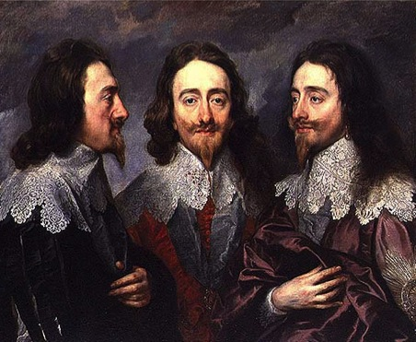
1625–1649
Parliament challenges the power of King Charles I — use of legal processes to resolve a dispute
Issue
King Charles 1 became King of England in 1625. He believed in the divine right to rule.
Between 1625 and 1629, Charles only called parliament to sit when he wanted to impose taxes to raise money to fight wars.
Parliament condemned the king for not allowing it to have more say in decisions about how taxes were spent.
Charles did not call parliament again for another 11 years.
Points of view on the issue
The king believed in his right to rule as he pleased.
Parliament wanted more say in how taxes were being spent.

Slide 8
1625–1649
Parliament challenges the power of King Charles I — use of legal processes to resolve a dispute
Resolution of the dispute
Between 1642 and 1649, England went to war with itself. The country was divided between those who were loyal to the king (Royalists) and those who were loyal to the parliament (Parliamentarians).
Parliamentarians won the war and defeated the King.
Parliament believed they could no longer trust King Charles I, and that peace was impossible as long as the king lived. The King was put on trial in a High Court of Justice*.
* established in 1649 by the House of Commons
The importance of the solution
King Charles I was found guilty of treason by a judge and jury, and, in 1649, became the only king in English history to be executed.

Slide 9
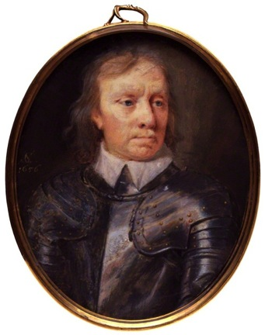
1649–1660
Rule without the monarchy
— challenges to the use of democratic processes to resolve disputes
Issue
In 1649, Parliament abolished the monarchy, the Church of England and the House of Lords. Only the House of Commons remained. However, by 1653, it too lost favour with the people as nothing had changed and taxes remained high.
Points of view on the issue
Oliver Cromwell believed he should take control of parliament. He made himself ‘Lord Protector’ of England. Over time, Cromwell wanted to take sole control of England.
Parliament opposed Cromwell’s ambitions and wanted to restore an English king to the throne.

Slide 10
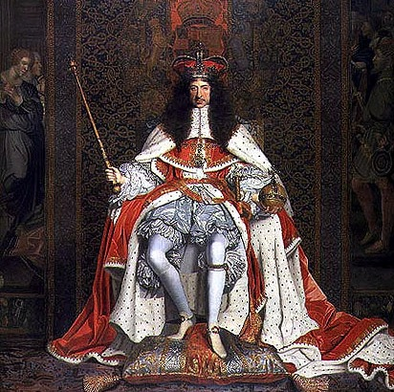
1660–1685
Charles II works with parliament — challenges to the use of democratic processes to resolve disputes
Resolution of the dispute
In 1660, parliament restored King Charles II, the son of King Charles I, to the English throne.
The importance of the solution
Parliament and King Charles shared the power for a time.
In 1681, Charles dissolved parliament and ruled alone until his death.

Slide 11
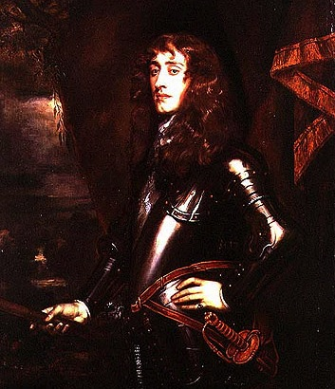
1685–1688
Final challenge for power in England — use of democratic processes to make decisions
Issue
In 1685 King James II ascended the throne. He was determined to reduce the influence of parliament.
Points of view on the issue
James II believed he had the right to suspend any laws made by Parliament. He wanted laws to promote religious tolerance.
Parliament refused and replaced James as king.

Slide 12
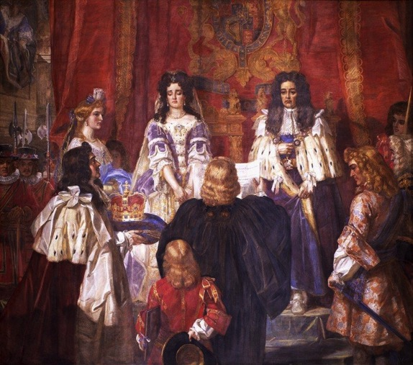
1689–1694
William III and Mary II hand control to parliament
— use of democratic processes to make decisions
Resolution of the dispute
The English parliament invited William and Mary of Orange to invade England.
The importance of the solution
King James II fled England, vacating the throne; parliament made a proclamation that England did not have a king.
William and Mary of Orange were crowned king and queen of England.
The roles of the monarchy and parliament were established, and this is now known as the Westminster system.

Slide 13
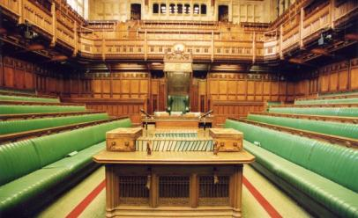
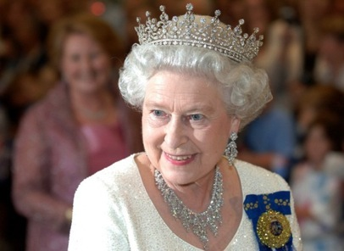
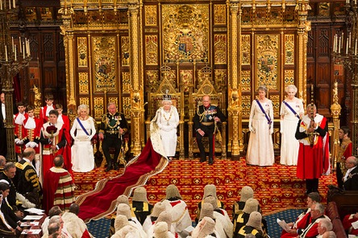
Present
Parliament and a constitutional monarchy — use of democratic processes to make decisions
The Westminster system is based on a system of rules and procedures, which allows parliament to meet and make decisions on behalf of the people.
The Westminster system consists of a head of state and parliament.
Today, Queen Elizabeth II is Britain’s head of state. She has an important formal and ceremonial relationship with parliament. Queen Elizabeth’s royal assent is required to all acts of parliament for them to become law.

Slide 14

Present
Australia’s parliamentary government
Parliamentary Education Office (www.peo.gov.au) CC BY-NC-ND 3.0 http://creativecommons.org/licenses/by-nc-nd/3.0/
Australia’s system of government is based on the Westminster system.
Queen Elizabeth II is Australia’s constitutional monarch because Australia is part of the Commonwealth of Nations.
When in Australia, the Queen attends the opening of parliament in the Senate.
It is impractical for the Queen Elizabeth II to give her royal assent for acts of parliament passed in Australia, so a Governor-General has been appointed to fulfil this role. The current Governor-General is Sir Peter Cosgrove.

Slide 15
Attributions
Slide 3:
King John I http://commons.wikimedia.org/wiki/File:John,_Magna_Carta.jpg
Slide 6:
Parliament vs monarch - unit of work © Commonwealth of Australia (TLF M009555) CC BY-SA creativecommons.org/licenses/by-sa/3.0/au/
Slides 7, 10 and 11
King Charles I, Royal Collection Trust/© Her Majesty Queen Elizabeth II 2014. Used with Permission.
Slide 9:
Oliver Cromwell © National Portrait Gallery, London. CC BY-NC-ND creativecommons.org/licenses/by-nc-nd/
Slide 10:
King Charles II, Royal Collection Trust/© Her Majesty Queen Elizabeth II 2014. Used with Permission.
Slide 11:
King James II, Royal Collection Trust/© Her Majesty Queen Elizabeth II 2014. Used with Permission.
Slide 12:
Ward, E.M., The Lords and Commons presenting the crown to William and Mary in the Banqueting house 1688 ID: WOA 2606 www.parliament.uk/art Contains Parliamentary information licensed under the Open Parliament Licence v3.0 www.parliament.uk/site-information/copyright/open-parliament-licence/
Slide 13:
UK Parliament, House of Common’s Chamber, Speaker’s table https://www.flickr.com/photos/uk_parliament/2700549757/ CC BY-NC-ND 2.0 creativecommons.org/licenses/by-nc-nd/2.0/
David Foote/Auspic, The Queen engaging in official duties, http://www.peo.gov.au/image-library/the-queen-engaging-in-official-duties/214.html CC BY-NC-ND 3.0 creativecommons.org/licenses/by-nc-nd/3.0/
UK Parliament, Queen’s Speech: The Royal Party – The Queen, the Duke of Edinburgh, the Prince of Wales and the Duchess of Cornwall – in the Lords chamber, https://www.flickr.com/photos/uk_parliament/14158885157/ CC BY-NC-ND 2.0 creativecommons.org/licenses/by-nc-nd/2.0/
Slide 14:
Parliamentary Education Office (www.peo.gov.au) CC BY-NC-ND 3.0 creativecommons.org/licenses/by-nc-nd/3.0/
References:
Website: Parliament versus Monarch (Civics and Citizenship Education, Discovering Democracy Units) http://www1.curriculum.edu.au/ddunits/units/up1parl-glance.htm
The official website of The British Monarchy http://www.royal.gov.uk/historyofthemonarchy/kingsandqueensoftheunitedkingdom/thestuarts/charlesi.aspx

